Slide 1
P.E JEWELLERY
E-project presentation

Slide 2
Group Members
S.no | Student ID
1 | Student1348437
2 | Student
3

Slide 3

Project Advisor
Respected Sir Muhammad Farhan
Aptech Computer Education
Korangi Center

Slide 4
Introduction
At Pascal imitation jewellery you are provided with 100% Quality and Trustable Products.
AT Pascal imitation jewellery you are able to shop with Ease plus Low Prices .
Pascal jewellery Always Provides High Quality and A High Range Of Products Mainly Available Only at Ours!
You can Easily Order with Trust from Our Website instead Of taking out time of your Business or Laziness.
At Pascal jewellery you are provided with The Latest Released Products Just A Step Away From Your Doorstep!

Slide 5
Technology Used
HTML 5
CSS 3
Bootstrap 5
JavaScript
Font Awesome
AOS Animation

Slide 6
Website Features
We have used bootstrap framework so as to make our website responsive. Although it is not as responsive as professional websites are, but we have tried basic implementation of a responsive website.
Smooth hovering effects have been used.
Color combination is according to Logo.
Easily Find Any product

Slide 7
Website Supported
 | Chrome | Firefox | Internet Explorer | Opera | Safari
Android | Supported | Supported | Supported | Supported | Supported
iOS | Supported | Supported | Supported | Supported | Supported
Mac OS X | Supported | Supported | Supported | Supported | Supported
Windows | Supported | Supported | Supported | Supported | Supported

Slide 8
Website Structure
 | Extra Small Devices (xs) | Small Devices (sm) | Medium devices (md) | Large devices (lg)
Device Type | Phone (<768) | Tablets (≥768px) | Desktops (≥992px) | Desktops (≥1200px)
Container width | None (auto) | 750px | 970px | 1170px
Class prefix | .col-xs- | .col-sm- | .col-md- | .col-lg-
No. of columns | 12
Columns width | Auto | ~62px | ~81px | ~97px
Gutter width | 30px (15px on each side of column)

Slide 9
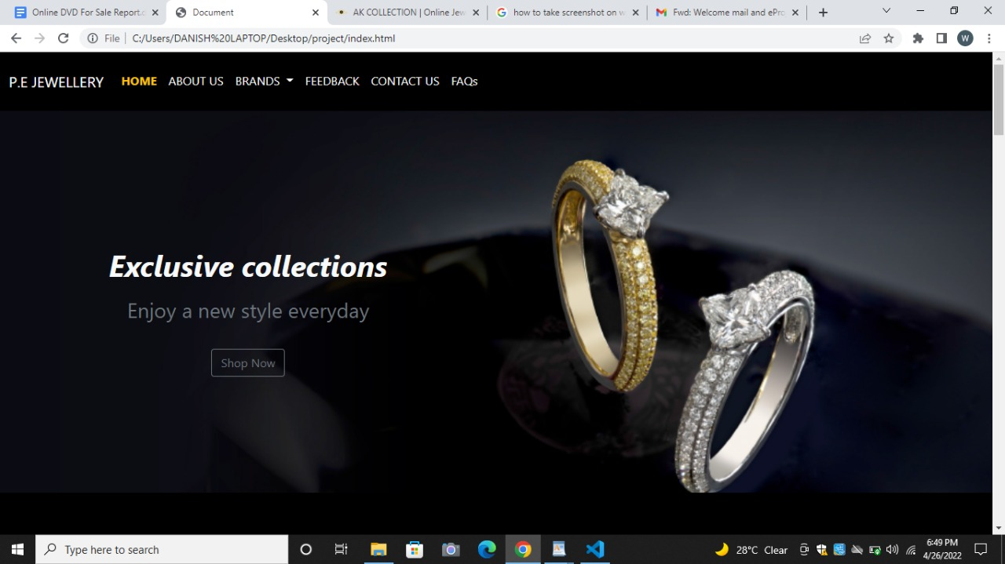
Home Page Screenshots

Slide 10
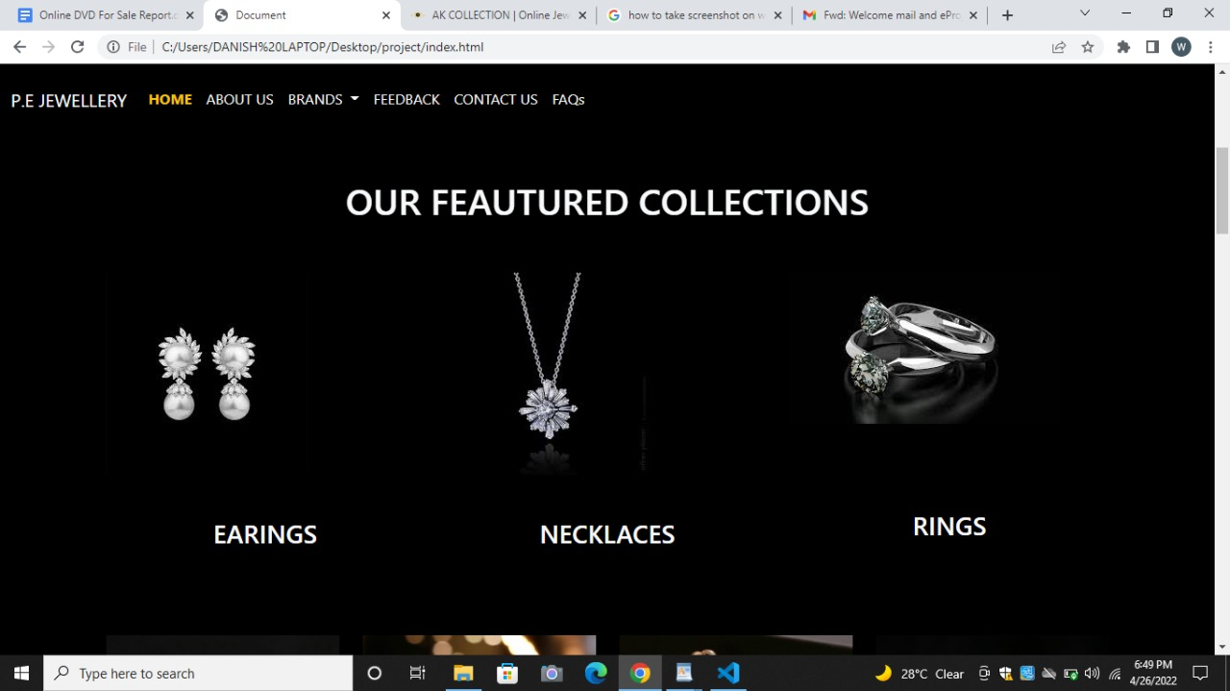

Slide 11
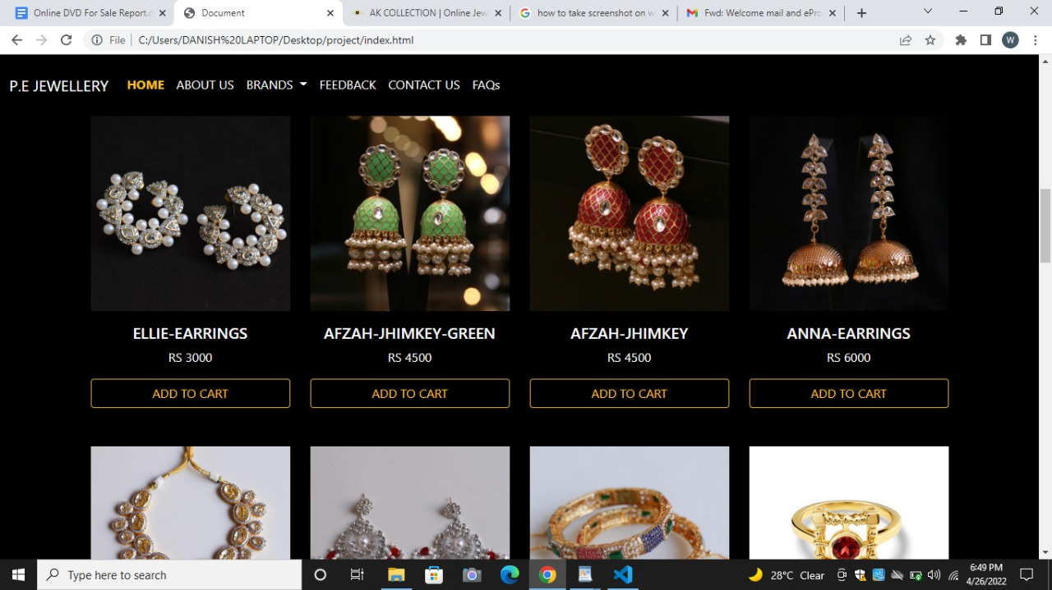

Slide 12
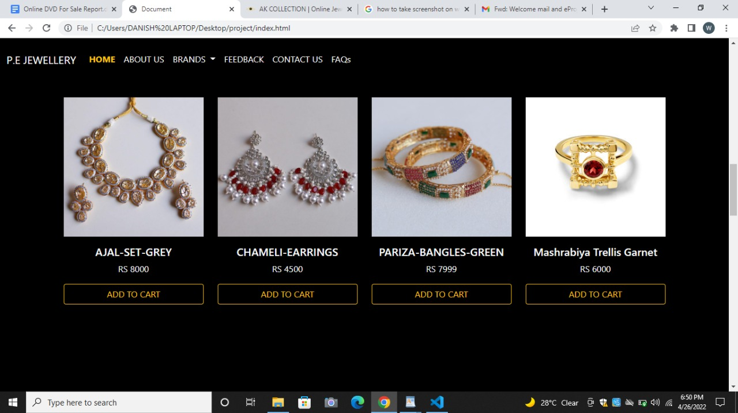

Slide 13
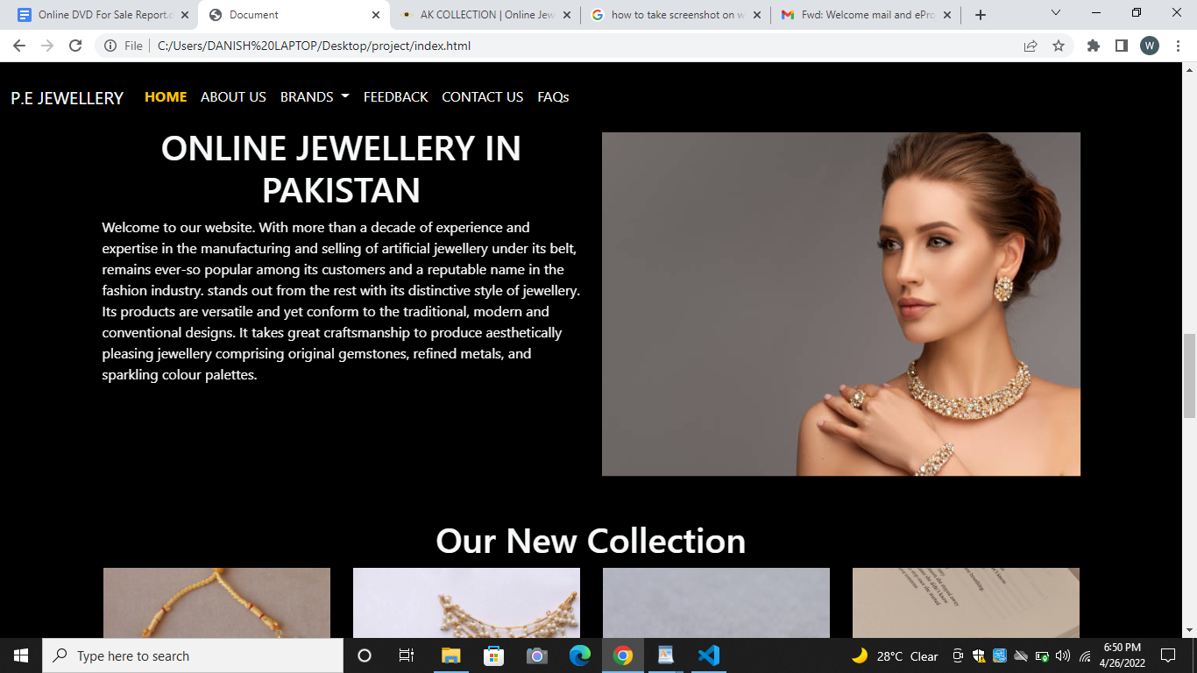

Slide 14
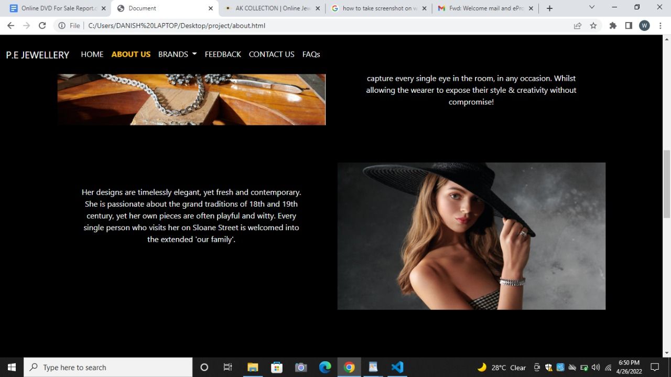

Slide 15
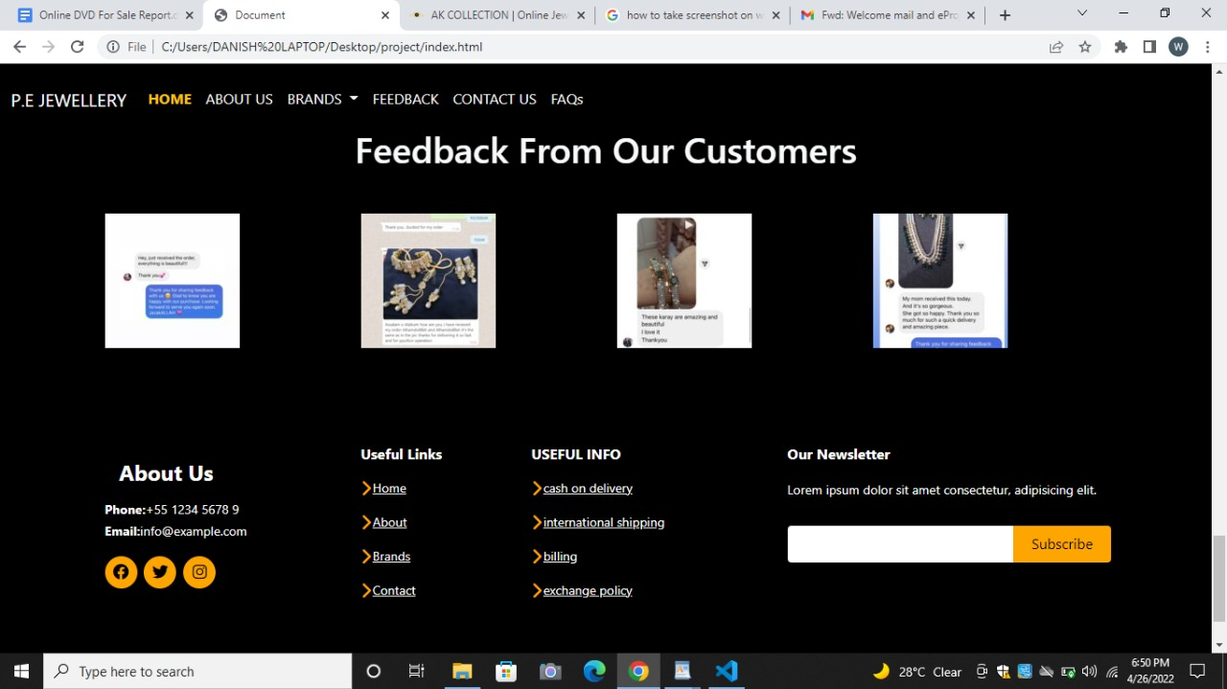

Slide 16
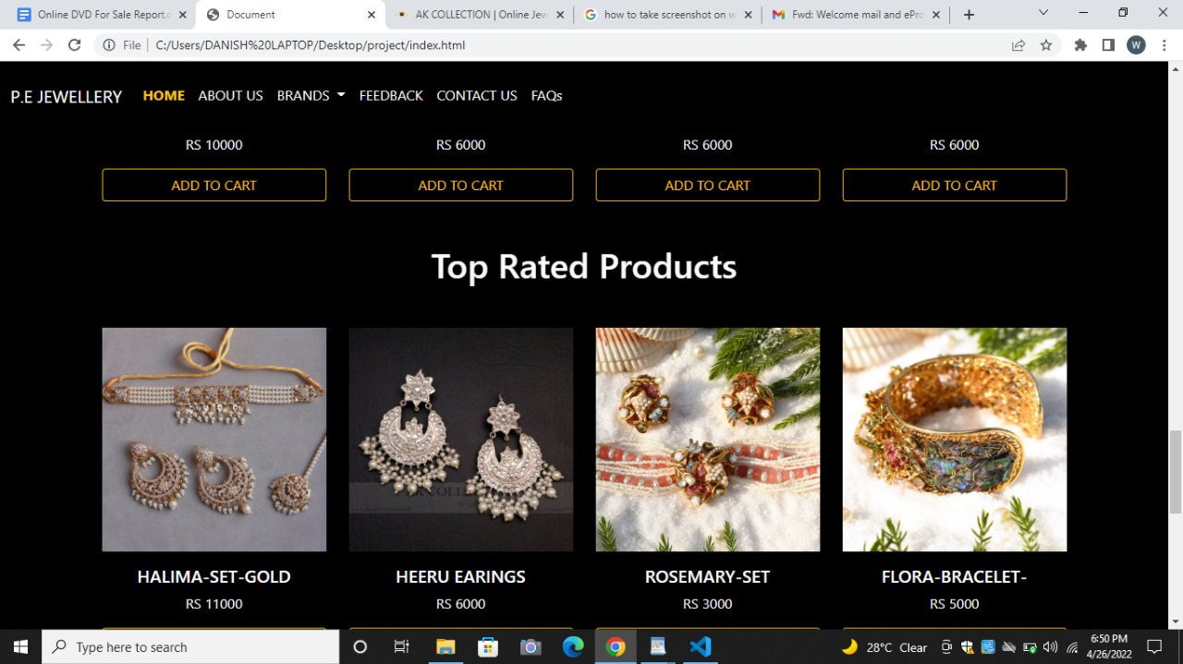

Slide 17
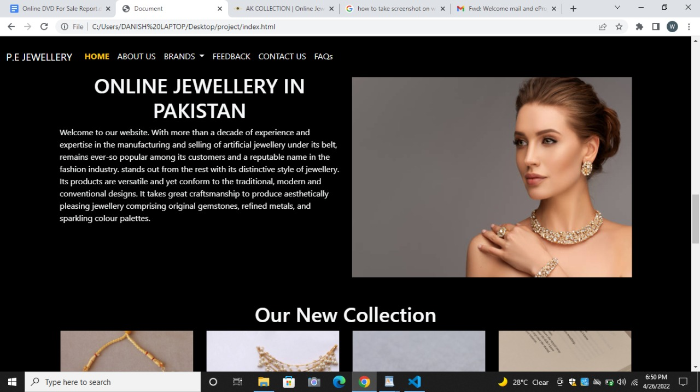

Slide 18
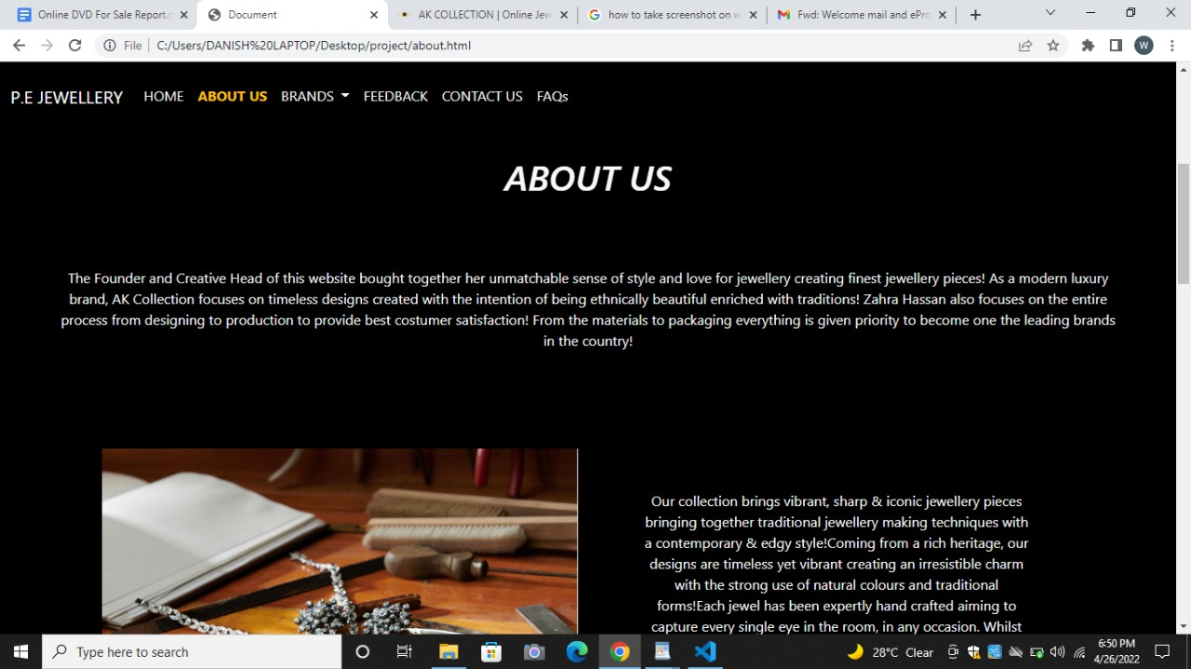

Slide 19
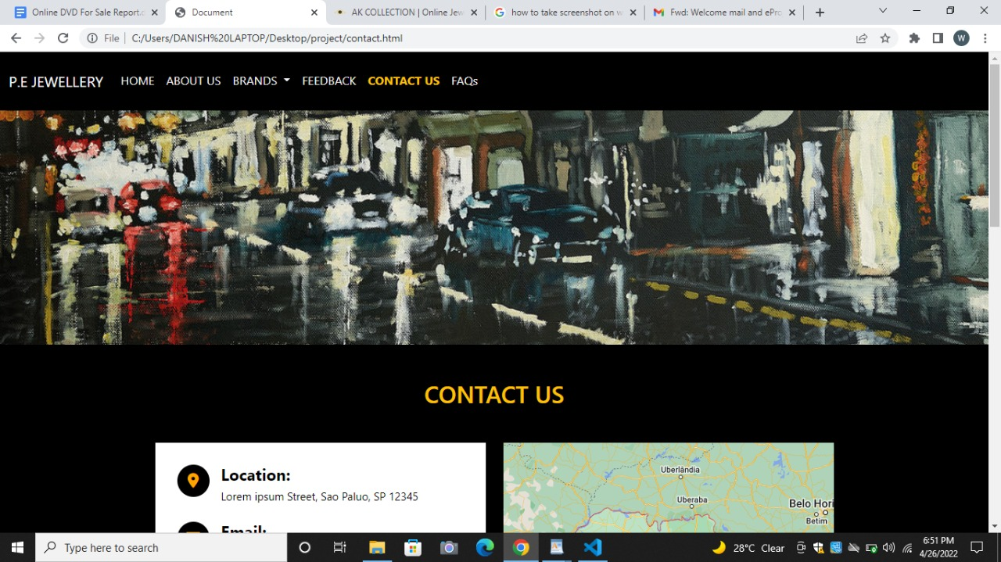

Slide 20
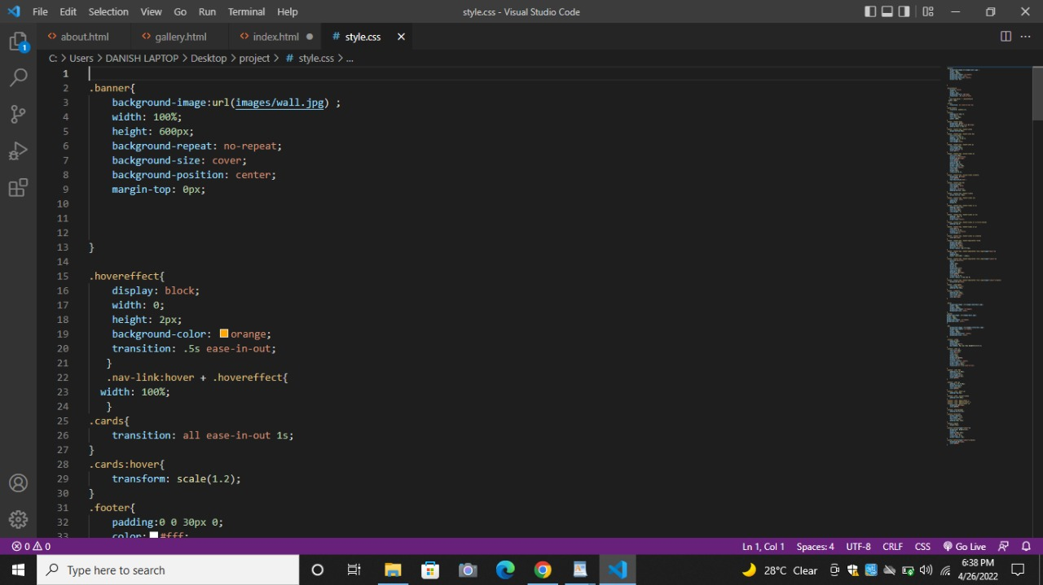
Source Code Screenshot

Slide 21
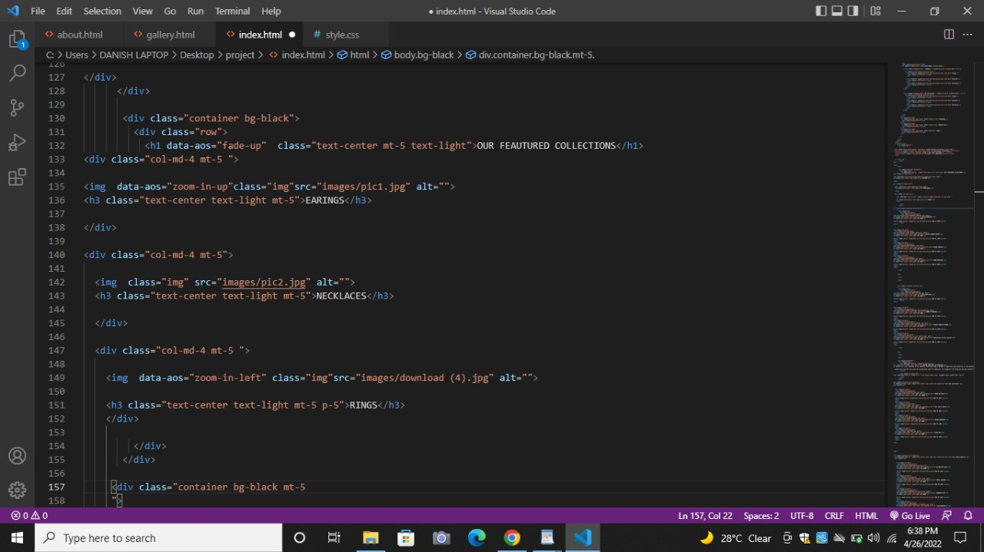

Slide 22
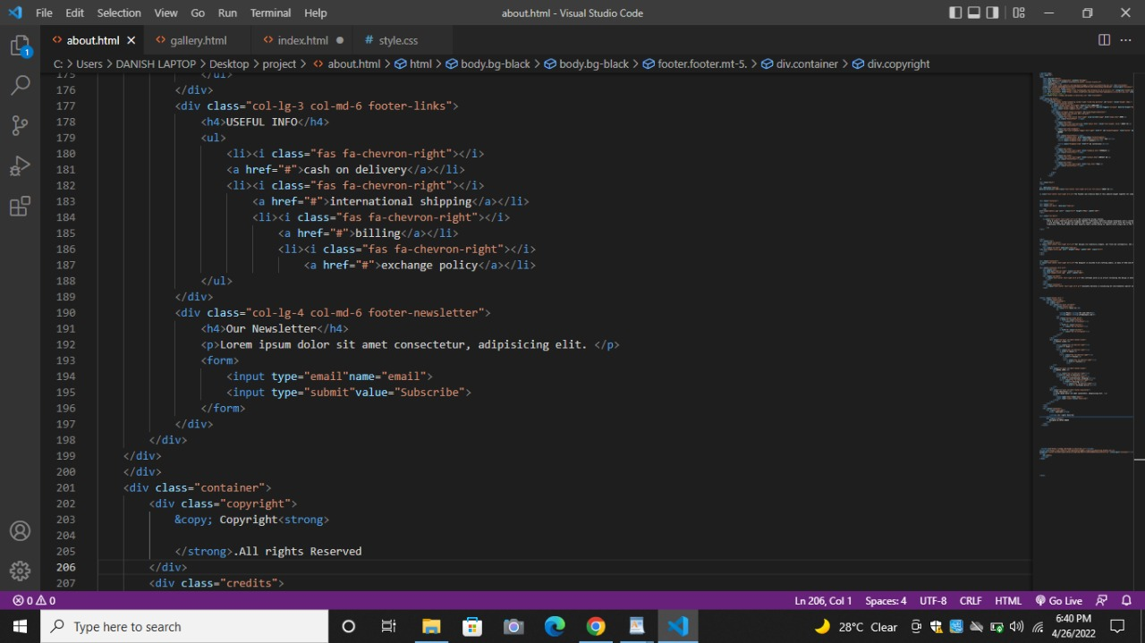

Slide 23
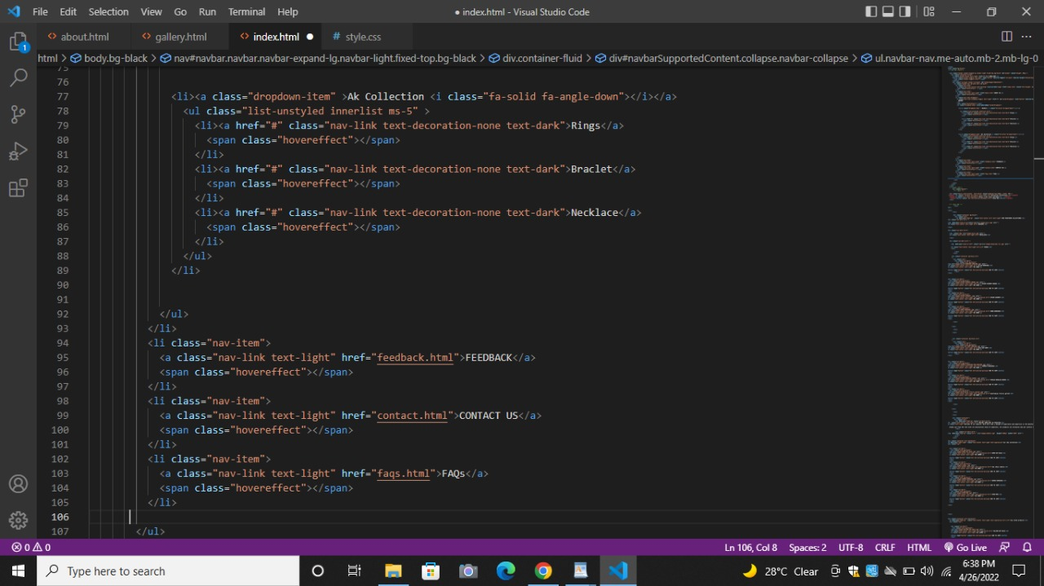

Slide 24
